Slide 1


PMI Toolkit
Overview

Slide 2
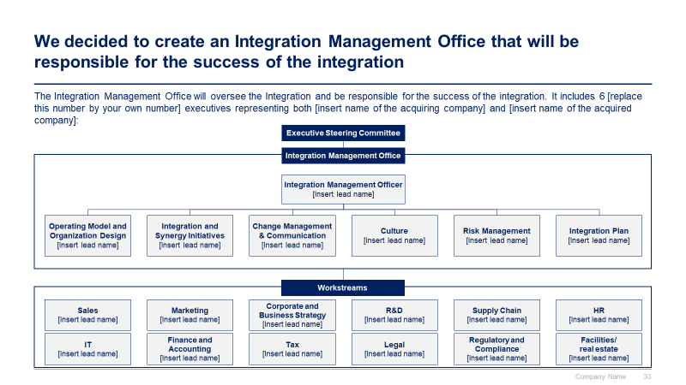
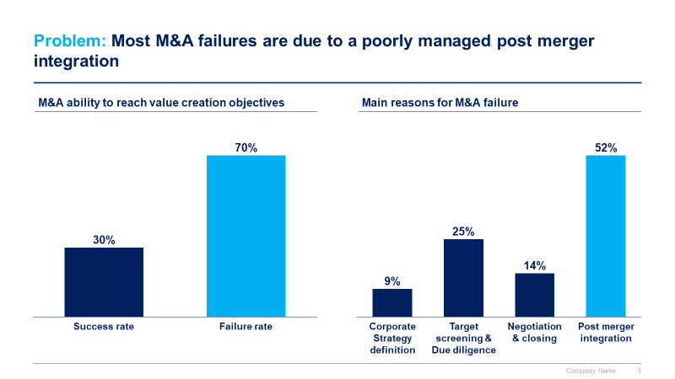
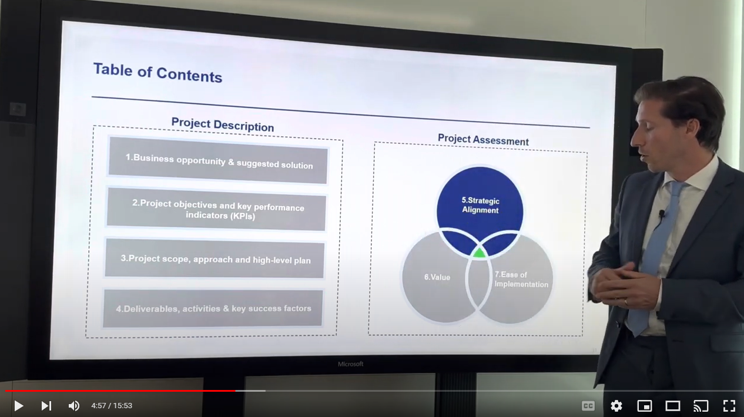
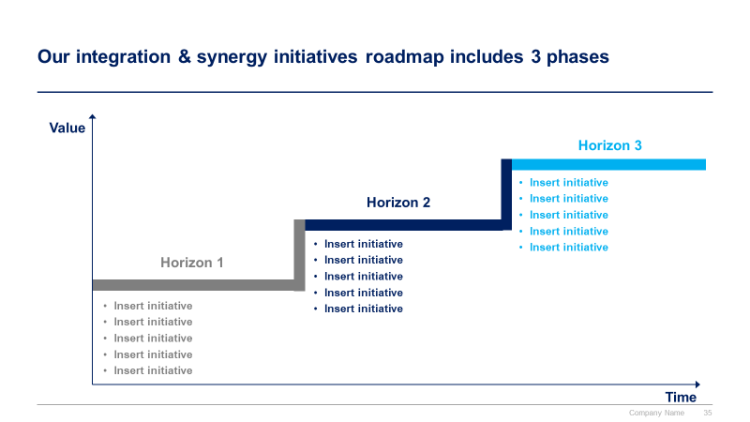
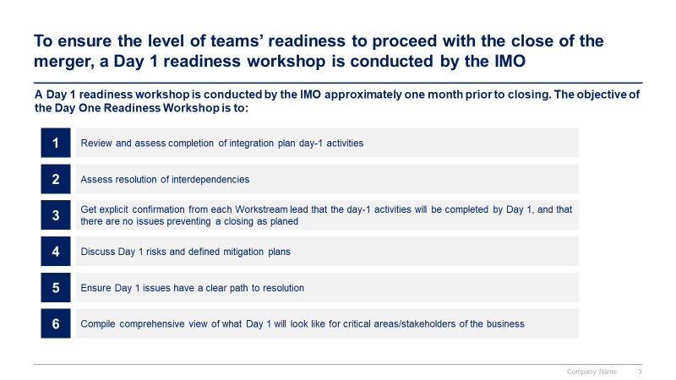
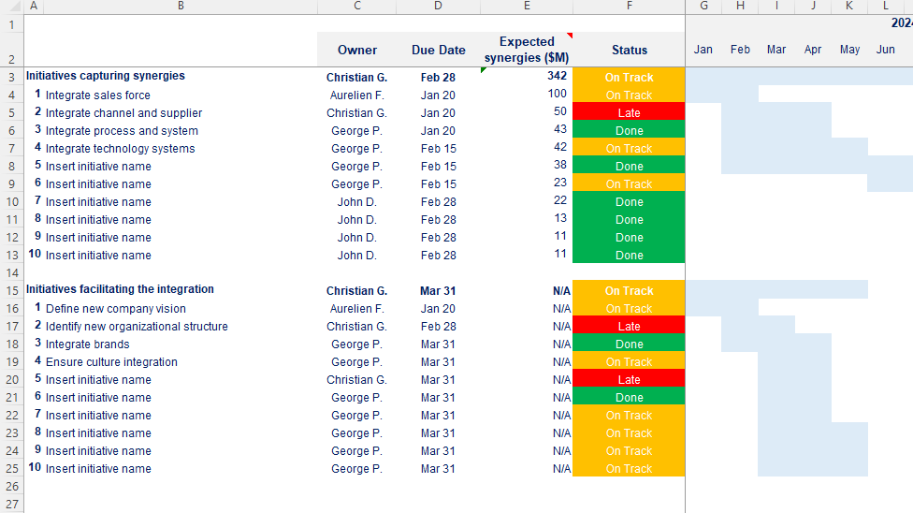
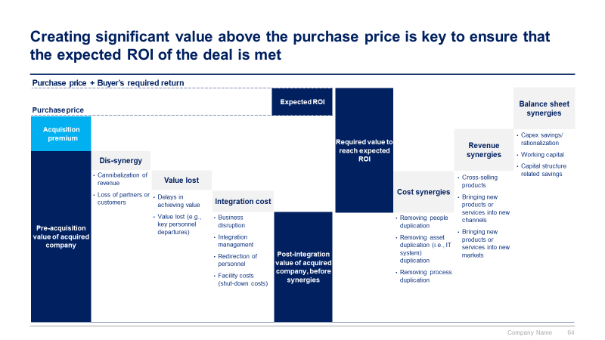
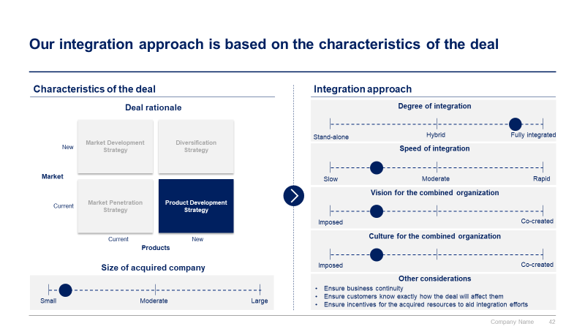
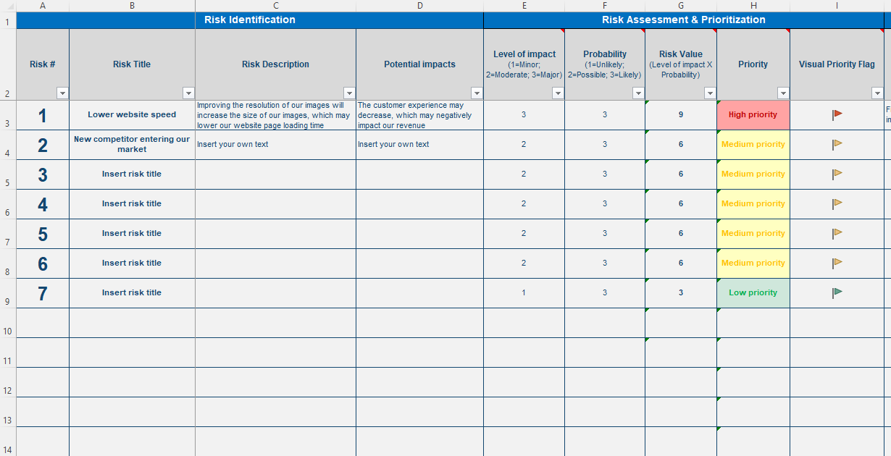

Slide 3


Introduction
This Toolkit was created by ex-McKinsey, Deloitte and BCG Management Consultants, after more than 3000 hours of work. It is considered the world's best & most comprehensive Post Merger Integration Toolkit. It includes all the Frameworks, Best Practices & Templates required to increase the value creation of your Mergers & Acquisitions.
Join the 200,000+ Executives, Consultants & Entrepreneurs who are already leveraging our Management Consulting Toolkits to improve the performance of their organization and boost their own career.
If you have any questions, send us an email at support@domontconsulting.com and one of our ex-McKinsey, Deloitte & BCG Management Consultants will get back to you within 2 business days.
Aurelien Domont
Management Consultant
Domont Consulting Managing Director

Slide 4
Problem: Most M&A failures are due to a poorly managed post merger integration
M&A ability to reach value creation objectives
Main reasons for M&A failure
Success rate
Failure rate
Corporate Strategy definition
Target screening & Due diligence
Negotiation & closing
Post merger integration
Source: Consolidation of multiple surveys from New York Times, Harvard Business Review, and Australia Financial Review

Slide 5












Solution: Our ex-McKinsey, Deloitte & BCG consultants created a PMI Toolkit to help you significantly increase your odds of success
What’s inside the Toolkit?
Who created the Toolkit?
The Toolkit was created by former McKinsey, Deloitte & BCG management consultants.
Best Practices
Frameworks
Number of professionals leveraging our Toolkits
Advice from
tier-1 Management Consultants
Tools
There are 200,000+ Executives, Consultants & Entrepreneurs leveraging our Toolkits to improve the performance of their organization
Real-life Examples
Templates
Trusted by small and large organizations
Video Training
Step-by-step Tutorials

Slide 6
Our Toolkit will help you fulfill multiple objectives
The Post Merger Integration Toolkit includes frameworks, tools, templates, tutorials, real-life examples, video training, and best practices to help you:
Conduct a successful post merger integration with our 6-phase approach: (I) Integration Strategy, (II) Integration & synergy initiatives, (III) Detailed Plans, (IV) Implementation & Monitoring, (V) Change Management and Internal Communication, and (VI) Stakeholder Engagement
(I) Define your integration strategy: (1) Deal rationale, (2) Merger strategic objectives, (3) Key performance indicators (KPIs), (4) Governance and Integration Management Office (IMO), (5) Guiding principles, (6) Integration approach, (7) Operating model and organization design, (8) Integrated synergy baseline, (9) Synergy targets
(II) Identify your integration & synergy initiatives: (1) Potential integration & synergy initiatives, (2) Business cases and financial models, (3) Integration & synergy initiatives prioritization, (4) Integration & synergy initiatives roadmap
(III) Create your detailed plans: (1) Integration plan: Day 1, Day 30, Day 60, Day 90, (2) Day one readiness workshop, (3) Staffing & retention plan, (4) Culture integration strategy and plan, (5) Risk management strategy and plan
(IV) Implement and monitor your integration: (1) Governance and Integration Management Office (IMO), (2) Dashboards: Strategic objectives and KPIs, Integration & synergy initiatives, Integration plan, Other detailed plans, (3) Training to help managers set up their team, (4) Integration lessons learned
(V) Define and implement your change management strategy and internal communication strategy: (1) Change management strategy, (2) Change management plans, (3) Implementation, tracking and progress management, (4) Effective communication
(VI) Engage your stakeholders effectively: (1) Stakeholder analysis, (2) Stakeholder engagement strategy, (3) Stakeholder engagement detailed plan

Slide 7

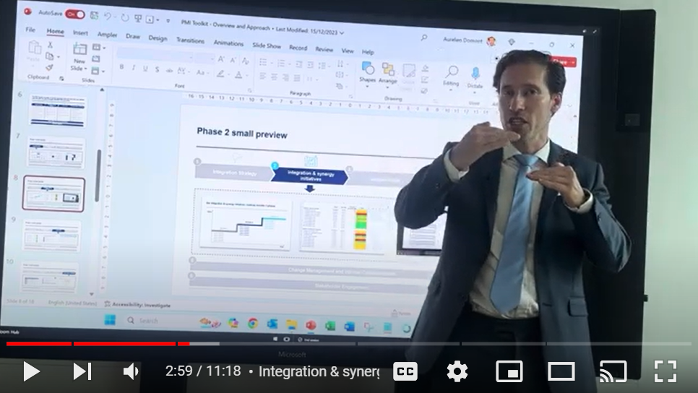
Video demonstration of the Toolkit
Video Demo Access
Video Demo Visual
Select “Slide Show” mode and then click on the link below or on the image on the right to access this video demo.
You can also access the video by copy pasting the following URL in your browser:
https://youtu.be/xEyGB451XAY

Slide 8


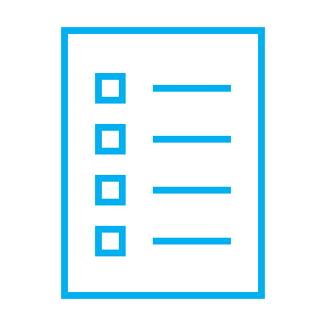

The PMI Toolkit includes a 6-phase approach that we have built and refined over the past 20 years through constant trial and error
1
2
3
4
Integration Strategy
Integration & Synergy Initiatives
Detailed Plans
Implementation & Monitoring
Deal rationale
Merger strategic objectives
Key performance indicators (KPIs)
Governance and Integration Management Office (IMO)
Guiding principles
Integration approach
Operating model and organization design
Integrated synergy baseline
Synergy targets
Potential integration & synergy initiatives
Business cases and financial models
Integration & synergy initiatives prioritization
Integration & synergy initiatives roadmap
Integration plan: Day 1, Day 30, Day 60, Day 90
Day one readiness workshop
Staffing & retention plan
Culture integration strategy and plan
Risk management strategy and plan
Governance and Integration Management Office (IMO)
Dashboards
Strategic objectives and KPIs
Integration & synergy initiatives
Integration plan
Other detailed plans
Training to help managers set up their team
Integration lessons learned
5
Change Management and Internal Communication
6
Stakeholder Engagement

Slide 9



Phase 1 small preview
1
2
3
4
Integration Strategy
Integration & synergy initiatives
Detailed Plans
Implementation & Monitoring
5
Change Management and Internal Communication
6
Stakeholder Engagement

Slide 10

Phase 2 small preview
1
2
3
4
Integration Strategy
Integration & synergy initiatives
Detailed Plans
Implementation & Monitoring
5
Change Management and Internal Communication
6
Stakeholder Engagement

Slide 11
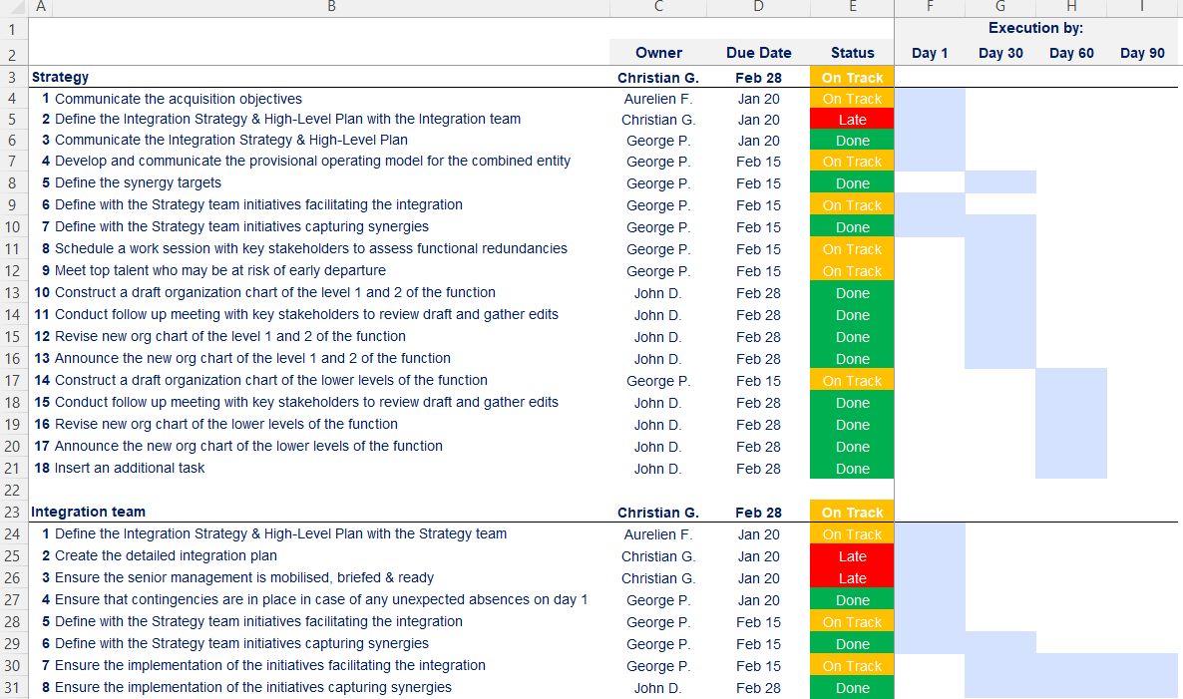
Phase 3 small preview
1
2
3
4
Integration Strategy
Integration & synergy initiatives
Detailed Plans
Implementation & Monitoring
5
Change Management and Internal Communication
6
Stakeholder Engagement

Slide 12
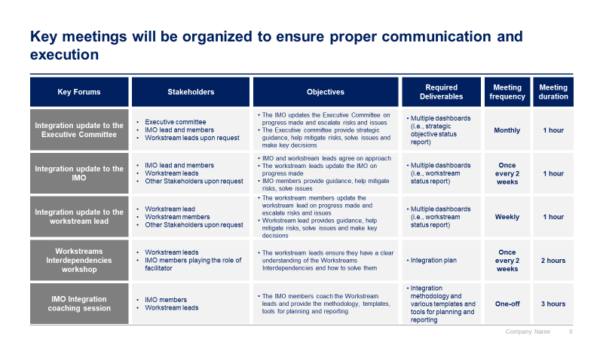
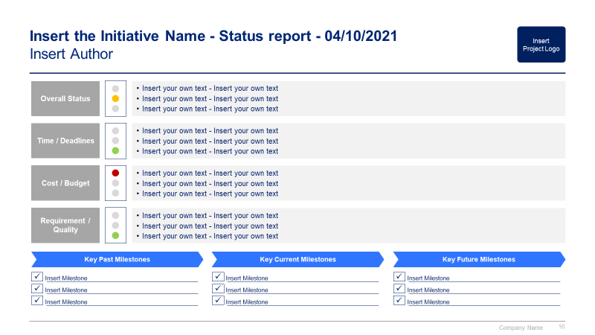
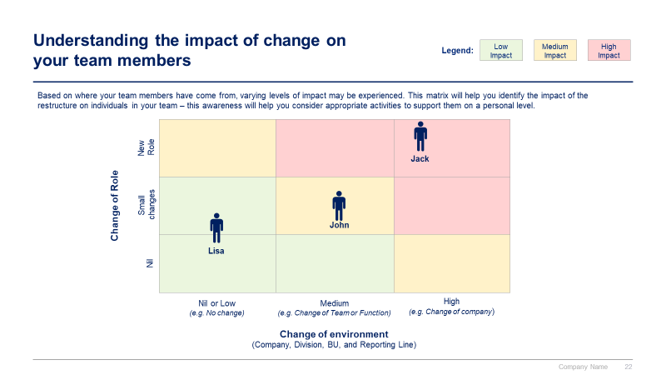
Phase 4 small preview
1
2
3
4
Integration Strategy
Integration & synergy initiatives
Detailed Plans
Implementation & Monitoring
5
Change Management and Internal Communication
6
Stakeholder Engagement

Slide 13
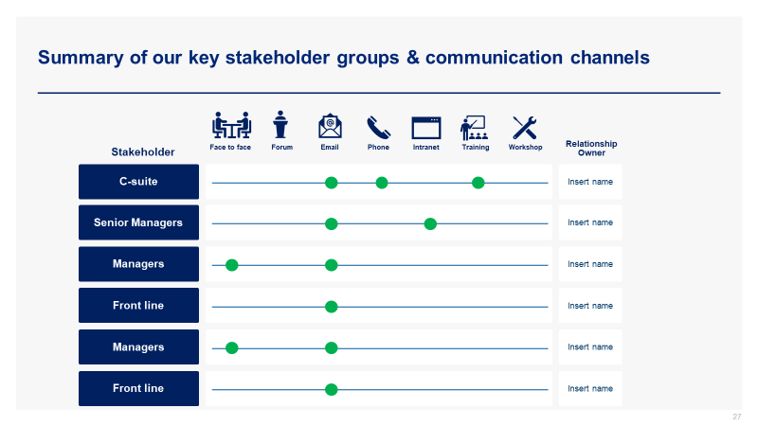
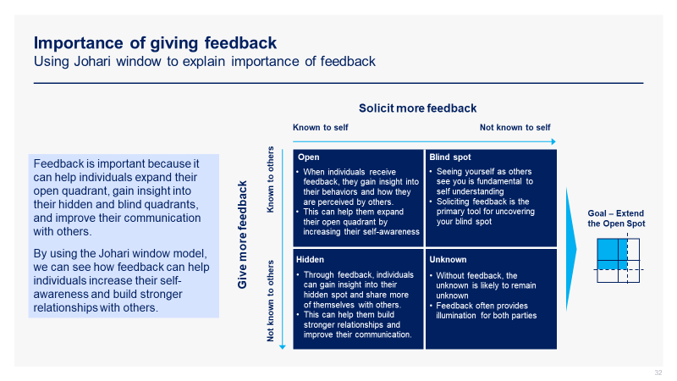
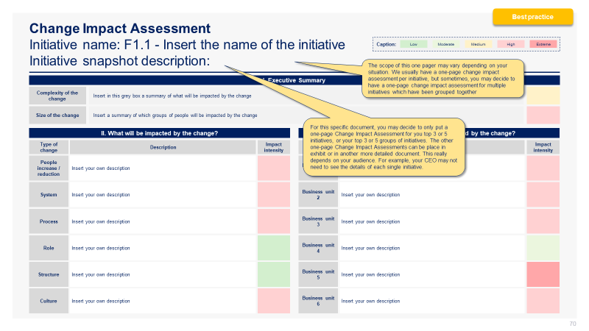
Phase 5 and 6 small preview
1
2
3
4
Integration Strategy
Integration & synergy initiatives
Detailed Plans
Implementation & Monitoring
5
Change Management and Internal Communication
6
Stakeholder Engagement

Slide 14

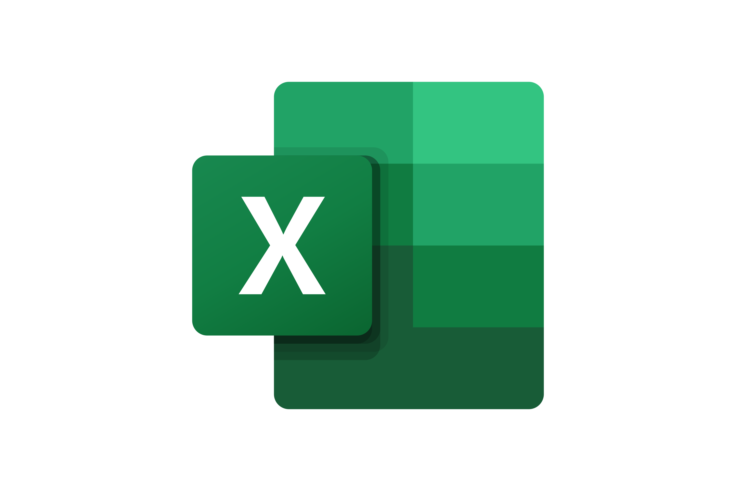

The Toolkit includes multiple PowerPoint slides, Excel sheets and Video training that you can download on your device immediately after purchase
600 editable PowerPoint slides*
33 Excel sheets*
52 minutes of Video training
0. Overview and Approach
1. Integration Strategy
2. Integration & synergy initiatives
3. Detailed Plans
4. Implementation & Monitoring
5. Change Management & Internal Communication
6. Stakeholder Engagement
*Please note that the number of Powerpoint slides and Excel sheets listed is the number of unique slides and sheets. For example, a Powerpoint slide that has been duplicated to facilitate our clients’ understanding only counts for one slide

Slide 15









Our Management Consulting Toolkits include 9 key benefits
Improve the growth & efficiency of your organization by leveraging Management Consulting Toolkits created by ex-McKinsey, Deloitte & BCG Consultants.
Make a great investment for your career & organization. It cost us US$8M+ over the past 10 years to create all our Toolkits. Get them for a fraction of this cost.
Get a competitive advantage. It’s like hiring Management Consultants to create all the practical Frameworks, Tools & Templates you need.
Get the job done quicker and never start from scratch again with our ready-made and fully editable Frameworks, Tools & Templates in Powerpoint & Excel.
Don't reinvent the wheel. We have already worked 30,000+ hours over the past 10 years to create all the Management Consulting Toolkits you need.
Improve the capabilities of your organization by learning how the Fortune 100 and Global Consulting Firms do it.
Decrease your costs. Hiring tier-1 Consultants for a project would cost you $300k+. Way more expensive than our Toolkits, which will last you a lifetime!
Become your organization’s subject matter expert and impress your stakeholders with world-class approaches to resolve common business problems.
Get free support and advice from our ex-McKinsey, Deloitte & BCG Management Consultants.

Slide 16
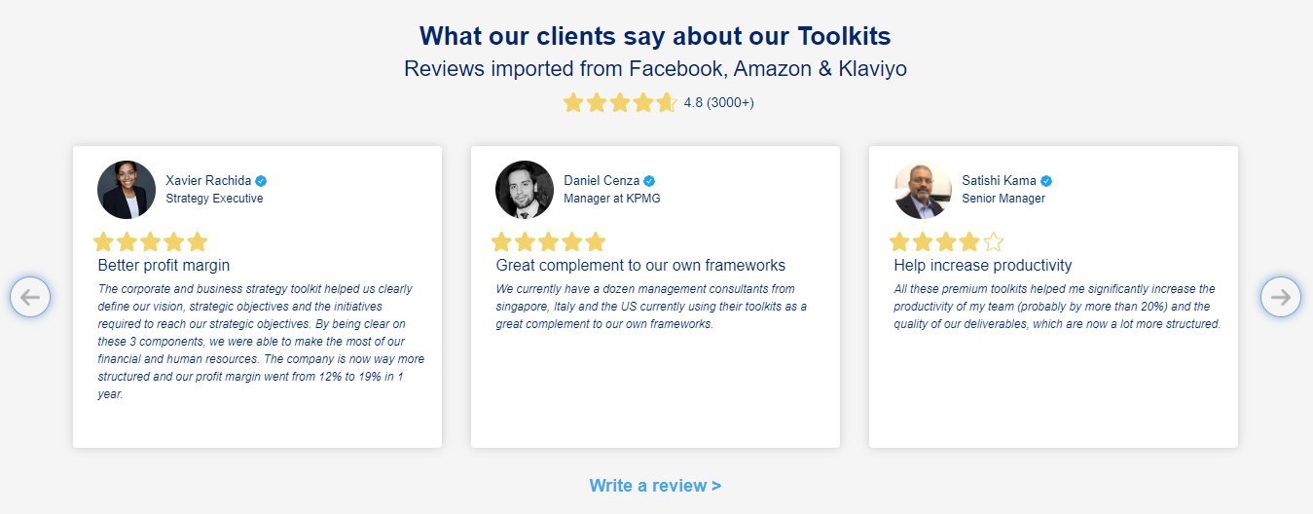
What our clients say about our Toolkits
Click here to see more reviews >

Slide 17

Join 200,000+ Executives, Consultants & Entrepreneurs leveraging our Toolkits to improve the performance of their organization
Trusted by small and large organizations
Customer satisfaction
4.8
Number of countries leveraging our Toolkits
160+
Number of professionals leveraging our Toolkits
200,000+
Daily rate of our ex-McKinsey, Deloitte and BCG Management Consultants
$3k-$4k

Slide 18

Interested in more than 1 Toolkit? Access all our Toolkits for half the price with our Gold Access
Gold Access
Click here to learn more

Slide 19
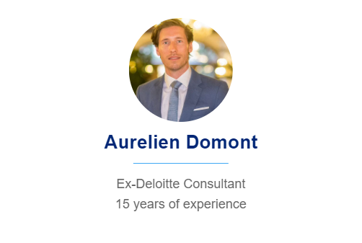
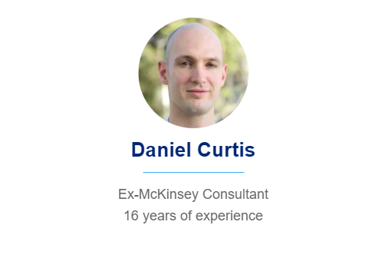
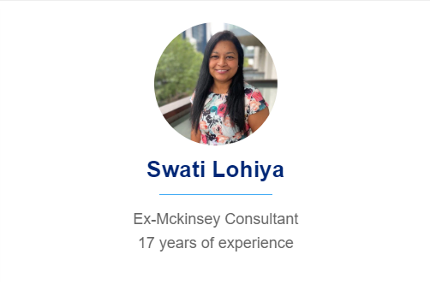
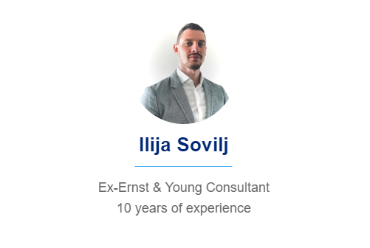
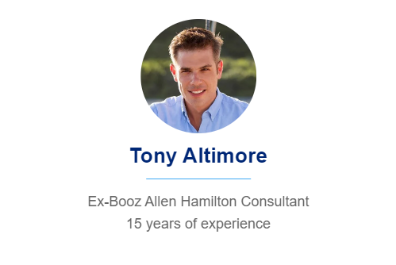
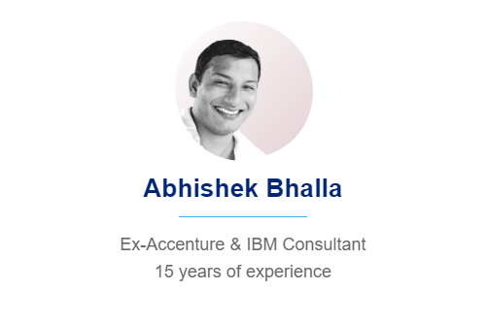
Need additional help? Send us a brief and we’ll find you the right talent from our network of 500+ tier-1 Management Consultants
Click here to send us a Project Brief

Slide 20

This was just a small preview.
www.domontconsulting.com

